Slide 2

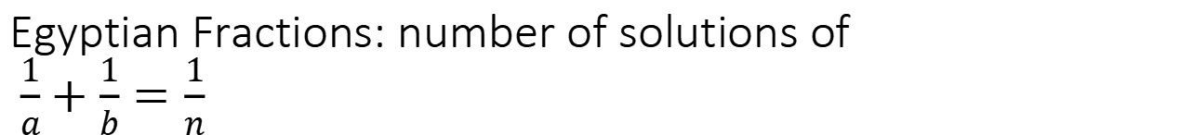
Egyptian Fractions: number of solutions of $\frac{1}{a}+\frac{1}{b}=\frac{1}{n}$
$ab = na+nb$
$ab − na−nb+n^{2}=n^{2}$
$a(b−n)−n(b−n)=(a−n)(b−n)=n^{2}$
number of solutions = number of divisors of $n^{2}$ including 1
for exmaple if n = 10; 1*100; 2*50, 4*25; 5*20 , 10*10...

Slide 3

Content:
$\frac{1}{k}+\frac{1}{m}=\frac{1}{2};k,m>0$
$\frac{1}{\sqrt{x}}+\frac{1}{\sqrt{y}}=\frac{1}{\sqrt{20}}$
$\frac{x}{x+1}+\frac{y}{y+1}+\frac{z}{z+1}=2 and \frac{1}{a}+\frac{1}{b}+\frac{1}{c}=1$
$\frac{1}{m}+\frac{1}{n}−\frac{1}{mn}=\frac{2}{5}=\frac{a}{b}$
$\frac{1}{m}+\frac{1}{n}+\frac{1}{mn}=\frac{a}{b}$
$\frac{1}{m}+\frac{1}{n}+\frac{1}{mn}=\frac{1}{4}(2 way)$

Slide 4


$$\frac{1}{k}+\frac{1}{m}=\frac{1}{2},x,y are Int, x,y>0$$
rewrite equasion for one variable:
$m=\frac{2k}{k−2}=2+\frac{4}{k−2}$
conclusion about integers:
k-2|4 => k-2 = 1,2 or 4;
k = 3,4,6;
m = 6,4,3

Slide 5
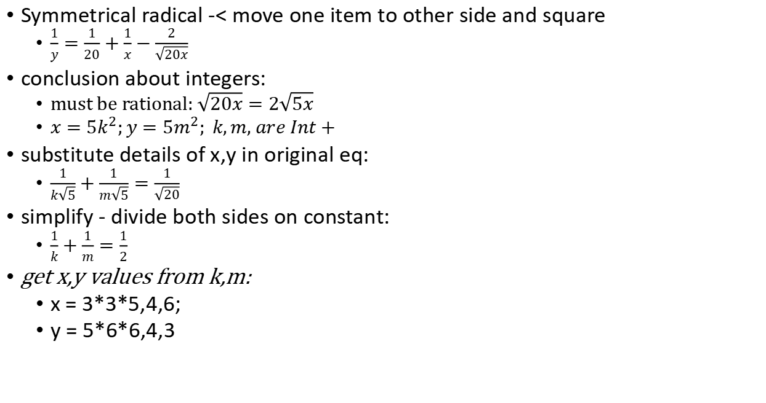
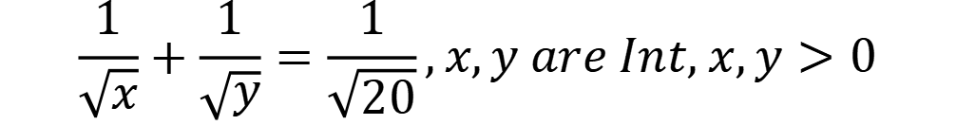
$$\frac{1}{\sqrt{x}}+\frac{1}{\sqrt{y}}=\frac{1}{\sqrt{20}},x,y are Int, x,y>0$$
Symmetrical radical -< move one item to other side and square
$\frac{1}{y}=\frac{1}{20}+\frac{1}{x}−\frac{2}{\sqrt{20x}}$
conclusion about integers:
must be rational: $\sqrt{20x}=2\sqrt{5x}$
$x=5k^{2};y=5m^{2}; k,m, are Int+$
substitute details of x,y in original eq:
$\frac{1}{k\sqrt{5}}+\frac{1}{m\sqrt{5}}=\frac{1}{\sqrt{20}}$
simplify - divide both sides on constant:
$\frac{1}{k}+\frac{1}{m}=\frac{1}{2}$
get x,y values from k,m:
x = 3*3*5,4,6;
y = 5*6*6,4,3

Slide 6
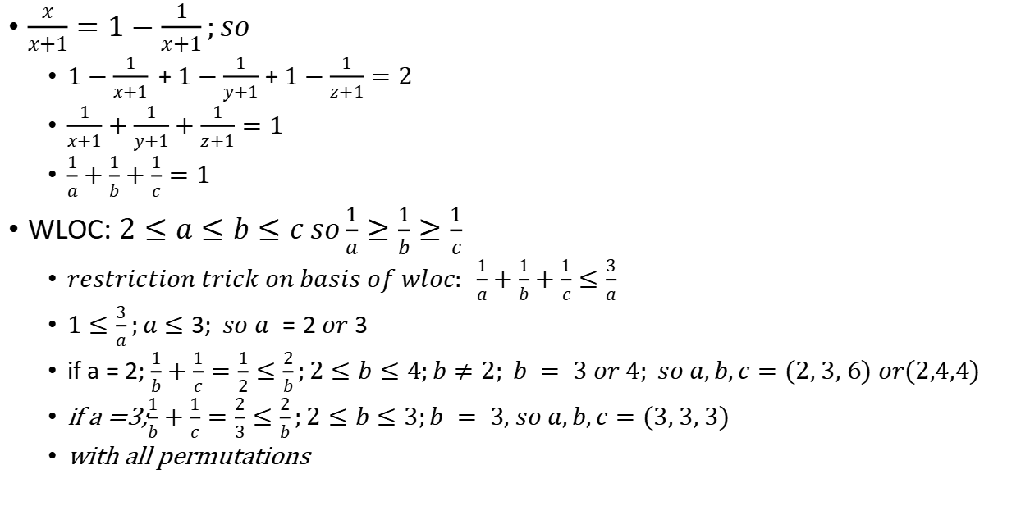
$$\frac{x}{x+1}+\frac{y}{y+1}+\frac{z}{z+1}=2$$
$\frac{x}{x+1}=1−\frac{1}{x+1};so$
$1−\frac{1}{x+1}$+$1−\frac{1}{y+1}$ + $1−\frac{1}{z+1}=2$
$\frac{1}{x+1}+\frac{1}{y+1}+\frac{1}{z+1}=1$
$\frac{1}{a}+\frac{1}{b}+\frac{1}{c}=1$
WLOC: $2≤a≤b≤c so\frac{1}{a}≥\frac{1}{b}≥\frac{1}{c}$
$restriction trick on basis of wloc: \frac{1}{a}+\frac{1}{b}+\frac{1}{c}≤\frac{3}{a}$
$1≤\frac{3}{a};a≤3; so a =2 or 3$
if a = 2; $\frac{1}{b}+\frac{1}{c}=\frac{1}{2}≤\frac{2}{b};2≤b≤4;b≠2; b = 3 or 4; so a,b,c=(2, 3, 6) or(2,4,4)$
if a =3;$\frac{1}{b}+\frac{1}{c}=\frac{2}{3}≤\frac{2}{b};2≤b≤3;b = 3, so a,b,c=(3, 3, 3)$
with all permutations

Slide 7
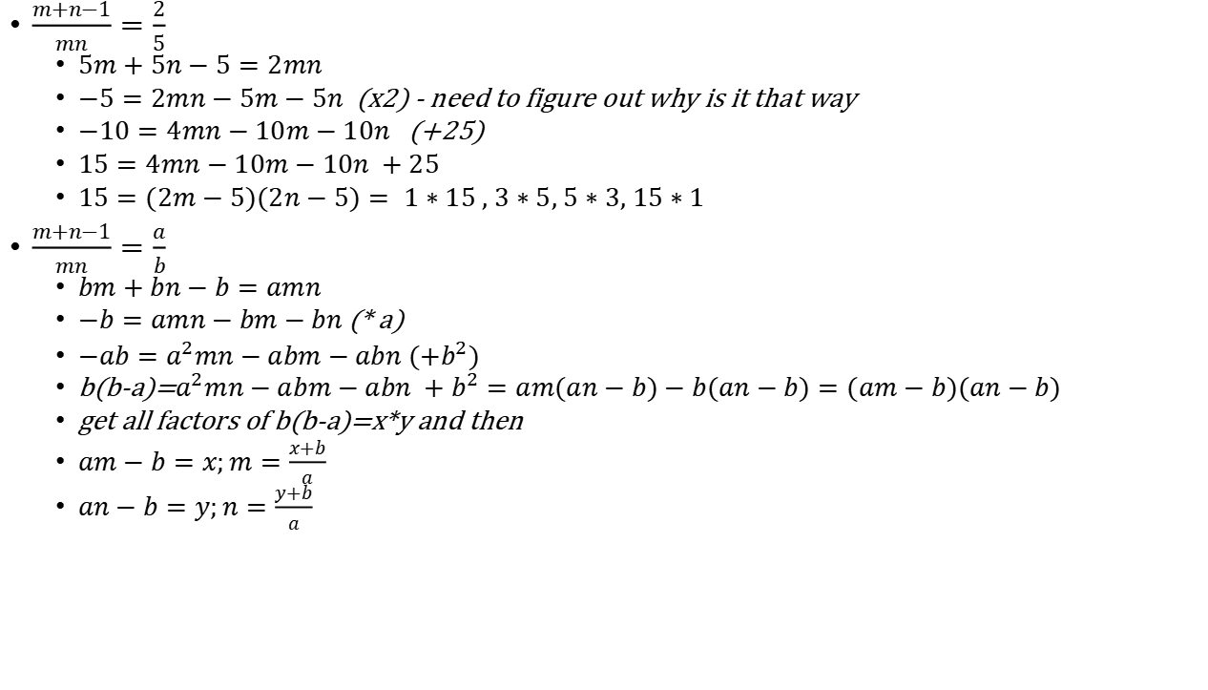

$$\frac{1}{m}+\frac{1}{n}−\frac{1}{mn}=\frac{2}{5}$$
$\frac{m+n−1}{mn}=\frac{2}{5}$
$5m+5n−5=2mn$
$−5=2mn−5m−5n$ (x2) - need to figure out why is it that way
$−10=4mn−10m−10n$ (+25)
$15=4mn−10m−10n +25$
$15=(2m−5)(2n−5)= 1∗15 , 3∗5, 5∗3, 15∗1$
$\frac{m+n−1}{mn}=\frac{a}{b}$
$bm+bn−b=amn$
$−b=amn−bm−bn$ (* a)
$−ab=a^{2}mn−abm−abn (+b^{2})$
b(b-a)=$a^{2}mn−abm−abn +b^{2}=am(an−b)−b(an−b)=(am−b)(an−b)$
get all factors of b(b-a)=x*y and then
$am−b=x;m=\frac{x+b}{a}$
$an−b=y;n=\frac{y+b}{a}$

Slide 8
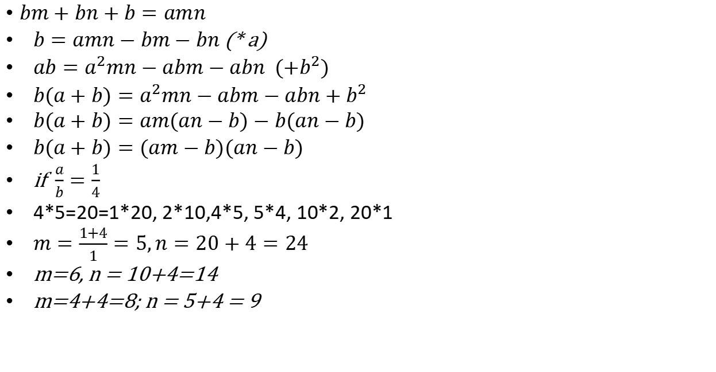
$$\frac{1}{m}+\frac{1}{n}+\frac{1}{mn}=\frac{a}{b}$$
$bm+bn+b=amn$
$b=amn−bm−bn$ (* a)
$ab=a^{2}mn−abm−abn$ $(+b^{2})$
$b(a+b)=a^{2}mn−abm−abn+b^{2}$
$b(a+b)=am(an−b)−b(an−b)$
$b(a+b)=(am−b)(an−b)$
if $\frac{a}{b}=\frac{1}{4}$
4*5=20=1*20, 2*10,4*5, 5*4, 10*2, 20*1
$m=\frac{1+4}{1}=5,n=20+4=24$
m=6, n = 10+4=14
m=4+4=8; n = 5+4 = 9

Slide 9
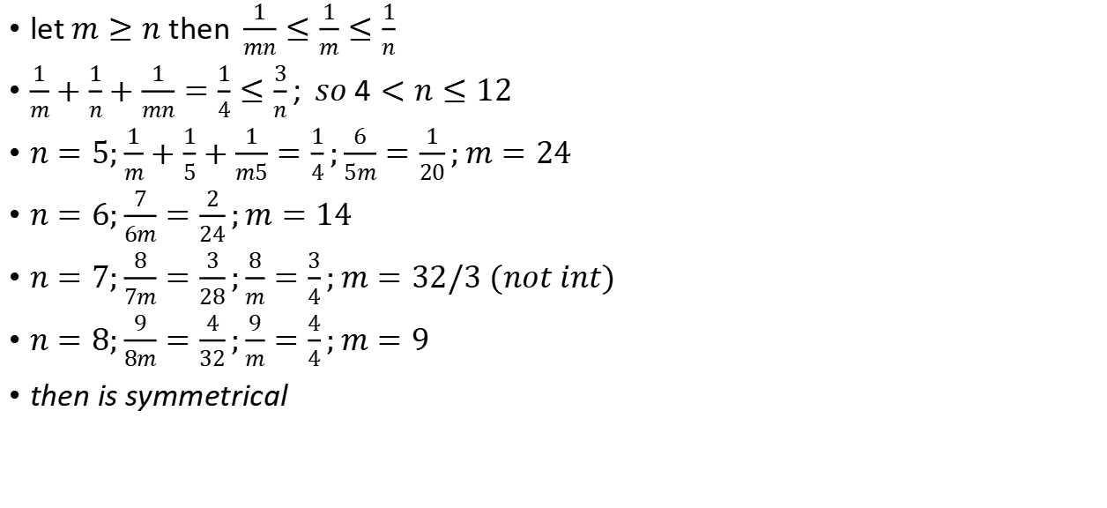

$$\frac{1}{m}+\frac{1}{n}+\frac{1}{mn}=\frac{1}{4}(2 way)$$
let$m≥n$ then$\frac{1}{mn}≤\frac{1}{m}≤\frac{1}{n}$
$\frac{1}{m}+\frac{1}{n}+\frac{1}{mn}=\frac{1}{4}≤\frac{3}{n}; so 4<n≤12$
$n=5;\frac{1}{m}+\frac{1}{5}+\frac{1}{m5}=\frac{1}{4};\frac{6}{5m}=\frac{1}{20};m=24$
$n=6;\frac{7}{6m}=\frac{2}{24};m=14$
$n=7;\frac{8}{7m}=\frac{3}{28};\frac{8}{m}=\frac{3}{4};m=32/3 (not int)$
$n=8;\frac{9}{8m}=\frac{4}{32};\frac{9}{m}=\frac{4}{4};m=9$
then is symmetrical

Slide 10

$$6a^{2}−13ab+6b^{2}=21$$
1) you can interchange a & b and/or negate both a & b in the original equation
2) the coefficients in each factor must be co-prime
3) the cross terms must sum to -13
Thus 6 must be split the same way in both factors and the positions of the coefficients are interchanged.
split to:
(2a-3b)(3a-2b)=21 = 3*7

Slide 11


$$\frac{1}{x}+\frac{1}{y}=\frac{1}{5}$$
$x≥y then\frac{1}{x}≤\frac{1}{y};\frac{1}{x}+\frac{1}{y}≤\frac{2}{y}$
$\frac{1}{5}≤\frac{2}{y}$
$5<y≤10$
reduce the range by:
$5x+5y=xy$
$x=\frac{5y}{y−5};\frac{y}{y−5}$ is integer
y = 6 or y = 10

Slide 12
pqr=7(p+q+r) - ?

Slide 13
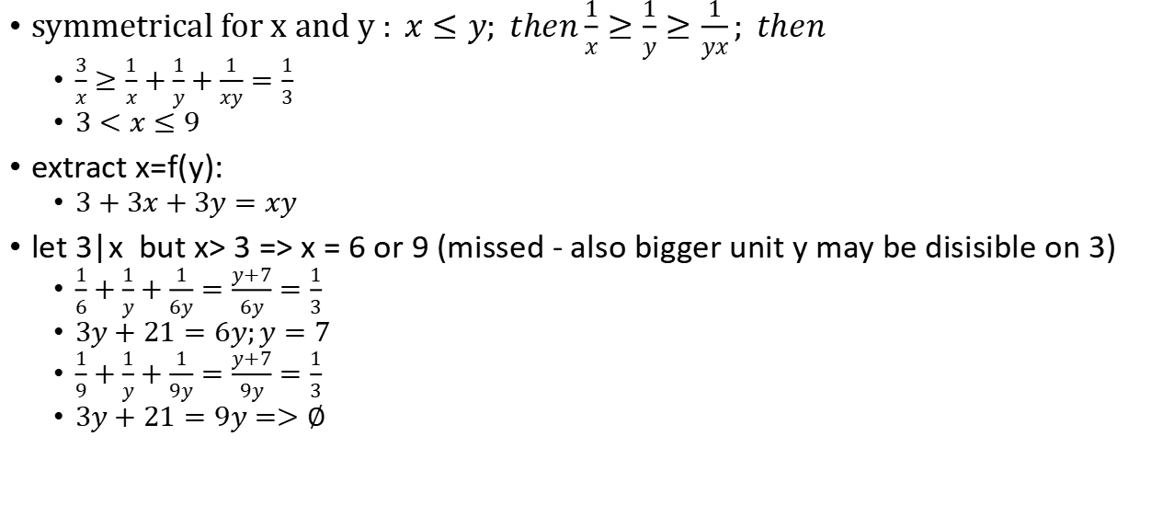

$$\frac{1}{x}+\frac{1}{y}+\frac{1}{xy}=\frac{1}{3}$$
symmetrical for x and y $: x≤y; then\frac{1}{x}≥\frac{1}{y}≥\frac{1}{yx}; then$
$\frac{3}{x}≥\frac{1}{x}+\frac{1}{y}+\frac{1}{xy}=\frac{1}{3}$
$3<x≤9$
extract x=f(y):
$3+3x+3y=xy$
let 3|x but x> 3 => x = 6 or 9 (missed - also bigger unit y may be disisible on 3)
$\frac{1}{6}+\frac{1}{y}+\frac{1}{6y}=\frac{y+7}{6y}=\frac{1}{3}$
$3y+21=6y;y=7$
$\frac{1}{9}+\frac{1}{y}+\frac{1}{9y}=\frac{y+7}{9y}=\frac{1}{3}$
$3y+21=9y=>∅$

Slide 14
Нелинейный диофант | Осторожно, спойлер! | Борис Трушин !
https://www.youtube.com/watch?v=CyjEc8LZ6_0&ab_channel=%D0%91%D0%BE%D1%80%D0%B8%D1%81%D0%A2%D1%80%D1%83%D1%88%D0%B8%D0%BD
m+n=mn
method 1 extract fraction
m(1-n)=-n
m=n/(n-1)=1+1/(n-1);
1/(n-1) is integer=> n = 2
method 2 split on factors
mn-m-n+1 = 1
(m-1)(n-1)=1; but m,n integers so m,n = 2 or m,n = 0

Slide 15
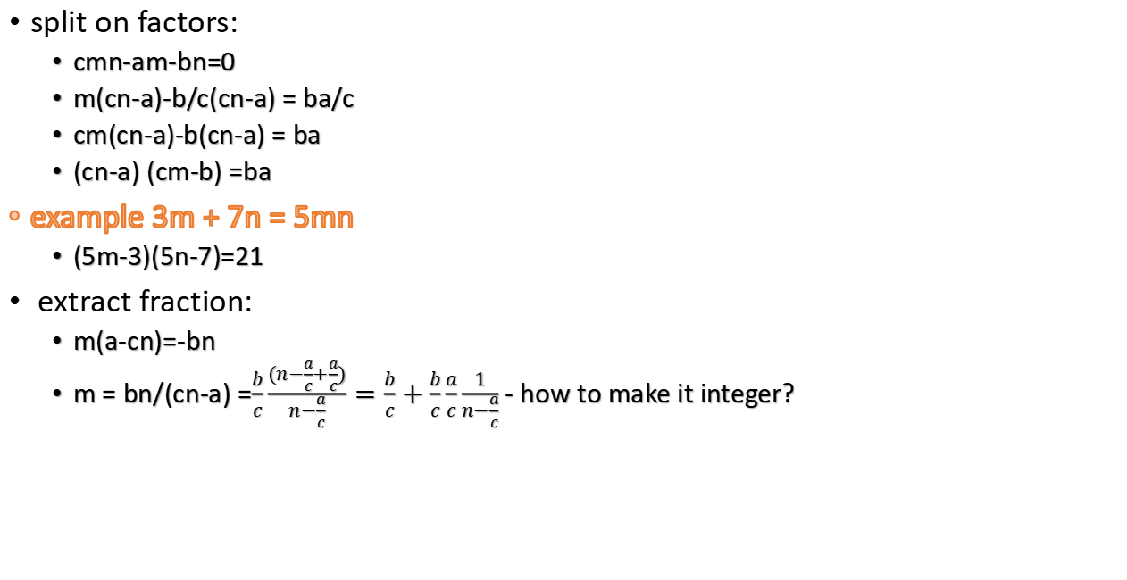
am + bn = cmn
split on factors:
cmn-am-bn=0
m(cn-a)-b/c(cn-a) = ba/c
cm(cn-a)-b(cn-a) = ba
(cn-a) (cm-b) =ba
example 3m + 7n = 5mn
(5m-3)(5n-7)=21
extract fraction:
m(a-cn)=-bn
m = bn/(cn-a) =$\frac{b}{c}\frac{(n−\frac{a}{c}+\frac{a}{c})}{n−\frac{a}{c}}=\frac{b}{c}+\frac{b}{c}\frac{a}{c}\frac{1}{n−\frac{a}{c}}$ - how to make it integer?

Slide 16
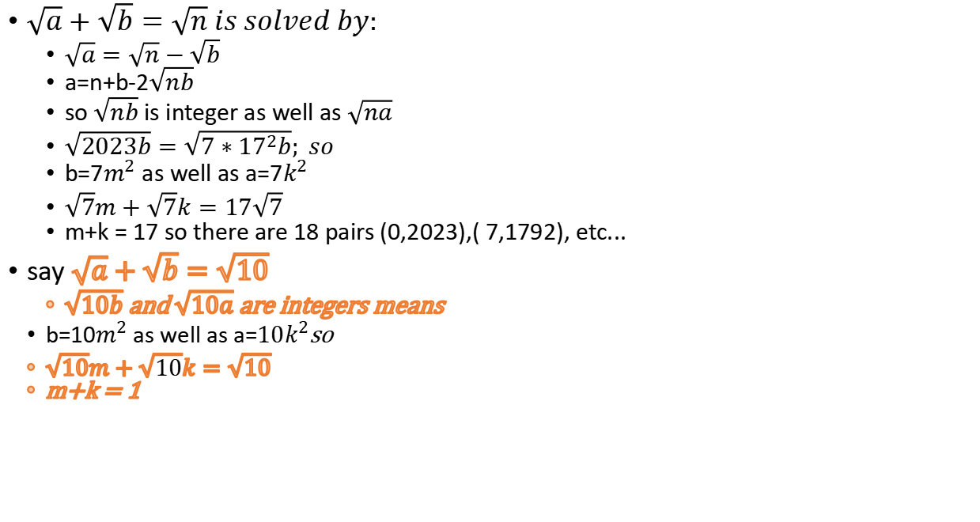
$$\sqrt{a}+\sqrt{b}=\sqrt{2023}$$
$\sqrt{a}+\sqrt{b}=\sqrt{n} is solved by:$
$\sqrt{a}=\sqrt{n}−\sqrt{b}$
a=n+b-2$\sqrt{nb}$
so $\sqrt{nb}$ is integer as well as $\sqrt{na}$
$\sqrt{2023b}=\sqrt{7∗{17}^{2}b}; so$
b=7$m^{2}$ as well as a=7$k^{2}$
$\sqrt{7}m+\sqrt{7}k=17\sqrt{7}$
m+k = 17 so there are 18 pairs (0,2023),( 7,1792), etc...
say $\sqrt{a}+\sqrt{b}=\sqrt{10}$
$\sqrt{10b}$ and $\sqrt{10a}$ are integers means
b=10$m^{2}$ as well as a=$10k^{2}$so
$\sqrt{10}m+\sqrt{10}k=\sqrt{10}$
m+k = 1

Slide 17

$x−yz = 11; xz+y = 13$; integers x,y,z
$x= 11+yz=\frac{13−y}{z}$

Slide 18
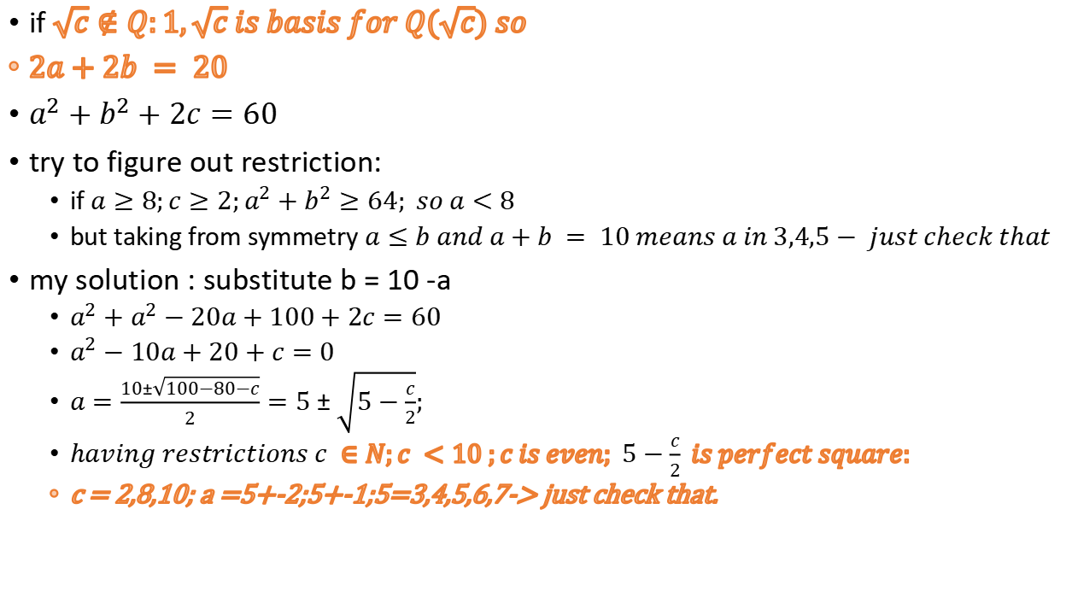
$${(a+\sqrt{c})}^{2}+{(b+\sqrt{c})}^{2}=60+20\sqrt{c};a,b,c∈N$$
if $\sqrt{c}∉Q:1,\sqrt{c} is basis for Q(\sqrt{c}) so$
$2a+2b = 20$
$a^{2}+b^{2}+2c=60$
try to figure out restriction:
if $a≥8;c≥2;a^{2}+b^{2}≥64; so a<8$
but taking from symmetry $a≤b and a+b = 10 means a in 3,4,5− just check that$
my solution : substitute b = 10 -a
$a^{2}+a^{2}−20a+100+2c=60$
$a^{2}−10a+20+c=0$
$a=\frac{10±\sqrt{100−80−c}}{2}=5±\sqrt{5−\frac{c}{2}};$
$having restrictions c ∈N;c <10 ;c is even; 5−\frac{c}{2} is perfect square:$
c = 2,8,10; a =5+-2;5+-1;5=3,4,5,6,7-> just check that.

Slide 19
x²-y²=12
(x-y)(x+y) = 12,
but both x-y and x+y must be even, or else if one of them is odd, the other must also be odd, what is not possible for factors of 12,
so the suitable pairs are only x+y=6 and x-y=2 and we have
x = 4 y = 2

